Slide 1
Introduction to Web Development
By- Chandramouli Haldar
Start
CHANDRAMOULI HALDAR, SVU,12-01-2026

Slide 2
What is Web Development?
Web development is the process of creating and maintaining websites and web applications that run on the internet. The word “Web” refers to the World Wide Web, a collection of interconnected web pages accessed through browsers, while “Development” means building, designing, and maintaining these pages using web technologies.
A website is a collection of related web pages stored on a server and accessed through a unique address called a URL. Websites are needed to provide information, offer online services, promote businesses, support communication, and enable global access to content anytime and anywhere.
CHANDRAMOULI HALDAR, SVU,12-01-2026

Slide 3
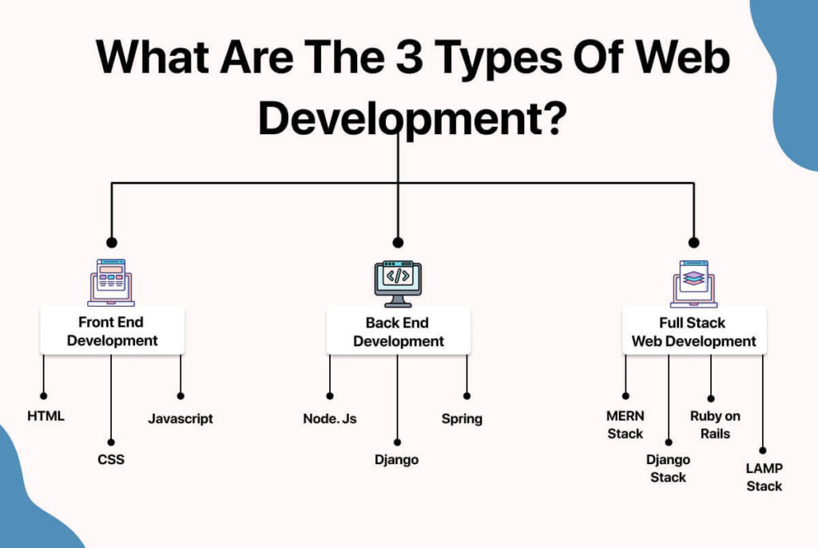
CHANDRAMOULI HALDAR, SVU,12-01-2026

Slide 4
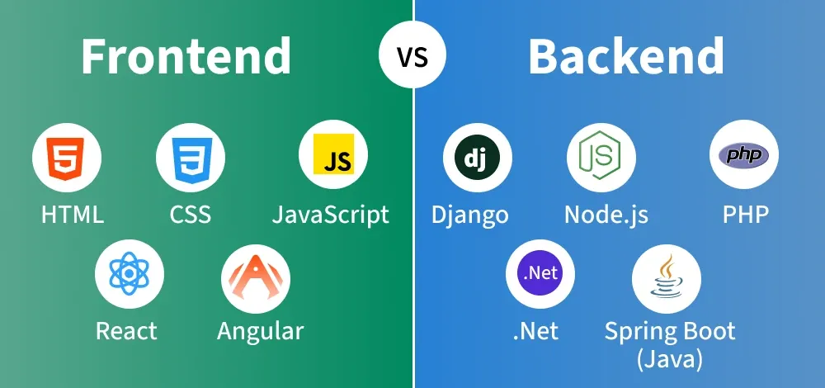
CHANDRAMOULI HALDAR, SVU,12-01-2026

Slide 5
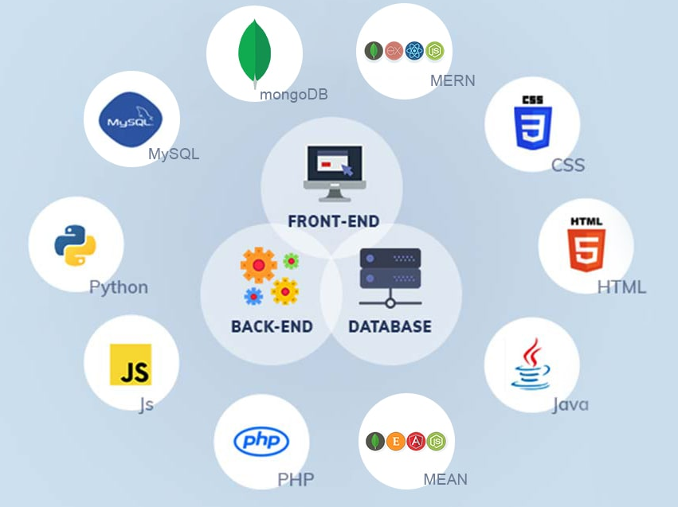
CHANDRAMOULI HALDAR, SVU,12-01-2026

Slide 6
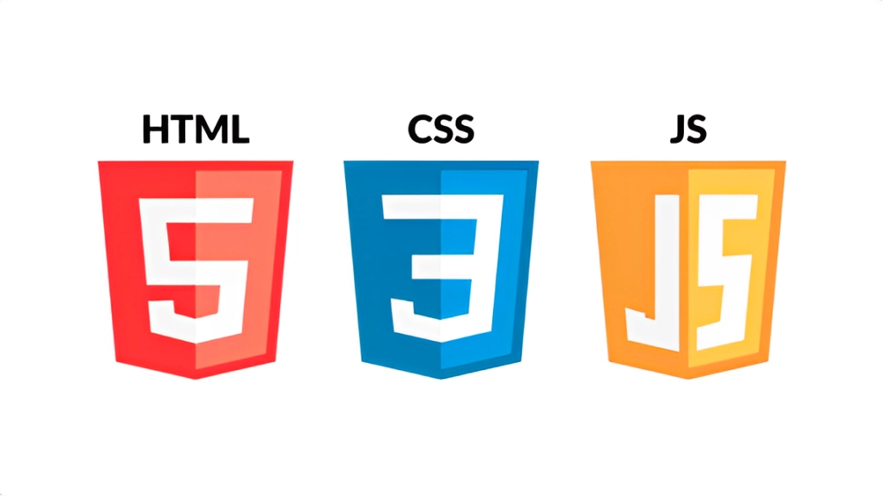
Get Started with Frontend Dev.
CHANDRAMOULI HALDAR, SVU,12-01-2026

Slide 7
01
Hyper Text Markup Language
Loading…
Okay
Hurry up
-The Importance of HTML: The Backbone of Every Web Page
CHANDRAMOULI HALDAR, SVU,12-01-2026

Slide 8
HTML
HTML is the backbone of every webpage. It’s the structure—the building blocks—that defines what your content looks like and how it’s organized.
HyperText refers to text that contains links, allowing users to navigate from one web page to another with a single click.
Markup Language uses predefined tags to mark and describe elements within a document. These tags tell the browser how to display and organize contents.
CHANDRAMOULI HALDAR, SVU,12-01-2026

Slide 9
02
Cascading Style Sheets
Loading…
Okay
Hurry up
-The Importance of CSS: The Makeup of Every Web Page
CHANDRAMOULI HALDAR, SVU,12-01-2026

Slide 10
CSS
While HTML is responsible for the structure of a webpage, CSS controls the visual appearance—how things look.
Cascading means priority and order of styles, Multiple CSS rules can apply to the same element browser decides which style to apply based on parameters.
Style Sheet is a file that contains CSS rules, These rules define how HTML elements should look
CHANDRAMOULI HALDAR, SVU,12-01-2026

Slide 11
03
JavaScript
Loading…
Okay
Hurry up
-The Importance of JS: The Brain of Every Web Page
CHANDRAMOULI HALDAR, SVU,12-01-2026

Slide 12
JavaScript
JavaScript is a Scripting language which is all about interacting with HTML elements and manipulating their appearance through CSS.
Scripting language is a programming language used to control and automate tasks, Scripts are executed line by line, No need for compilation before execution.
CHANDRAMOULI HALDAR, SVU,12-01-2026

Slide 13




JAVA VS JAVASCRIPT
Kim Jong Un
Kim Kardashian
CHANDRAMOULI HALDAR, SVU,12-01-2026

Slide 14
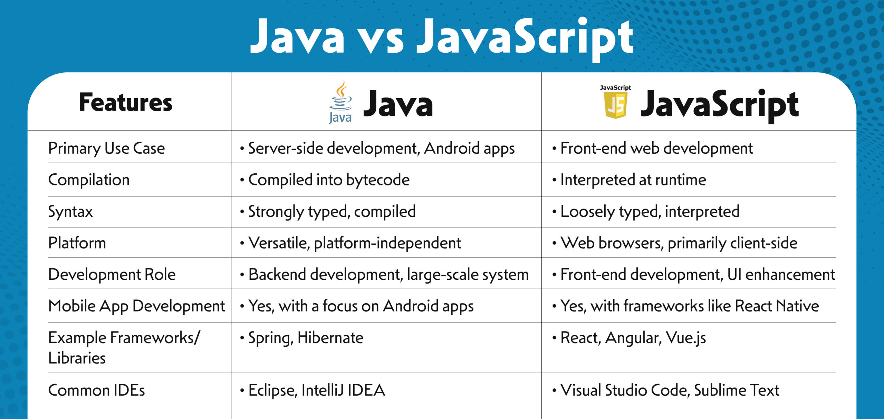
CHANDRAMOULI HALDAR, SVU,12-01-2026

Slide 15


Prerequisite Software
CHANDRAMOULI HALDAR, SVU,12-01-2026

Slide 16
Thank You!
CHANDRAMOULI HALDAR, SVU,12-01-2026

